Slide 1
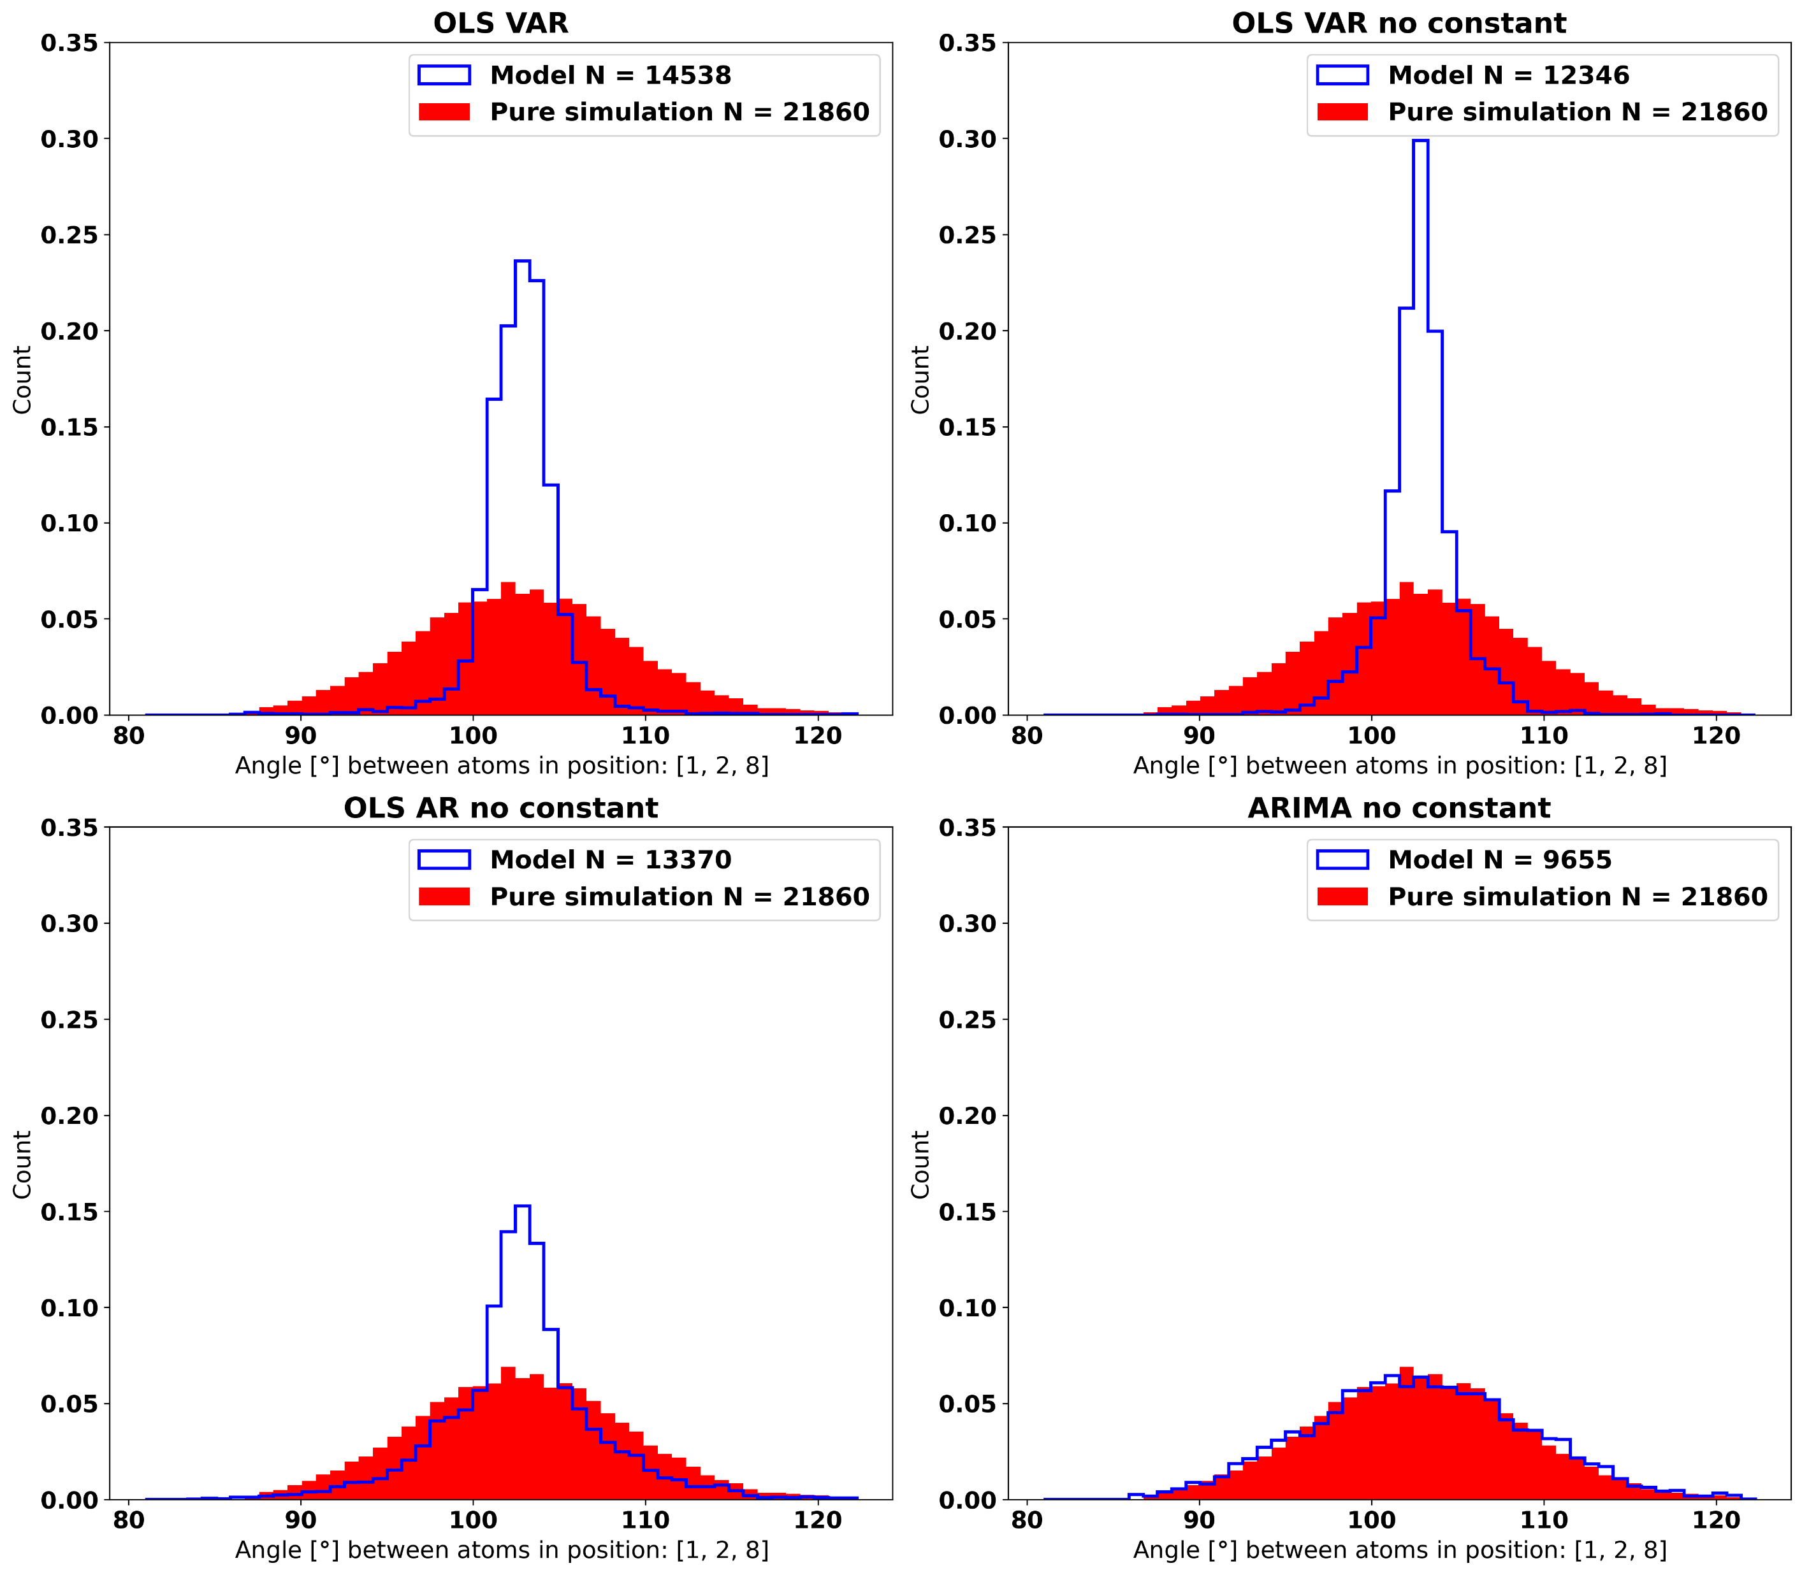

Slide 2
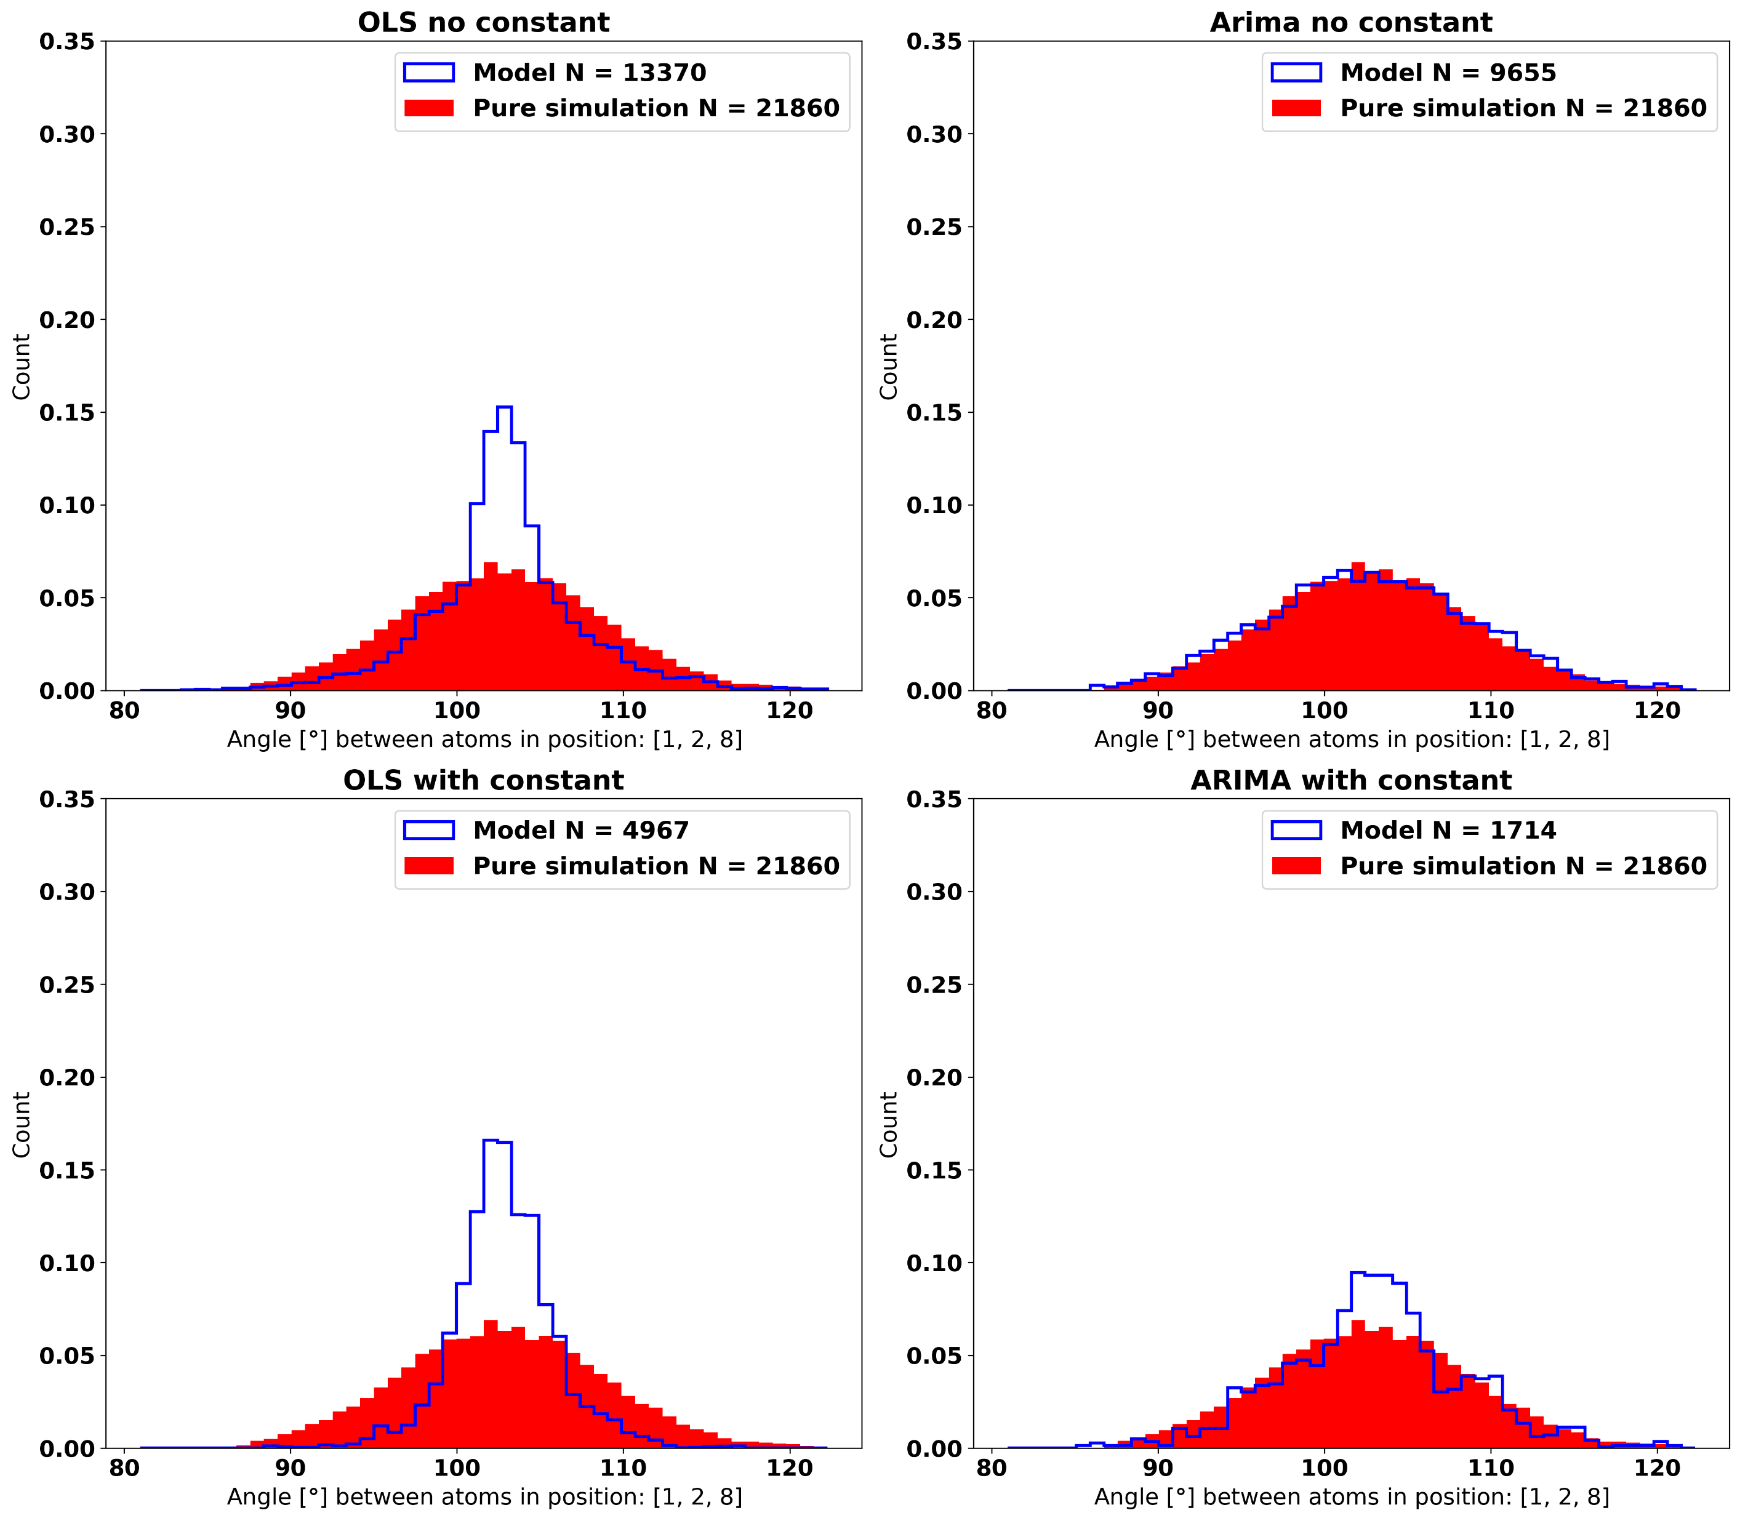

Slide 3
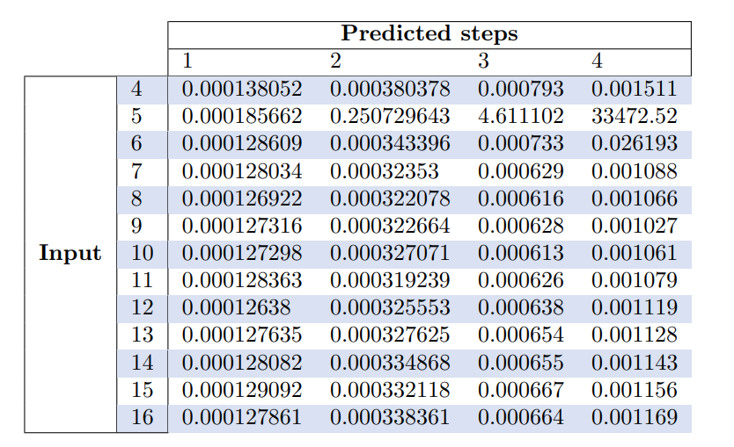
Grid search for hyperparameters

Slide 4
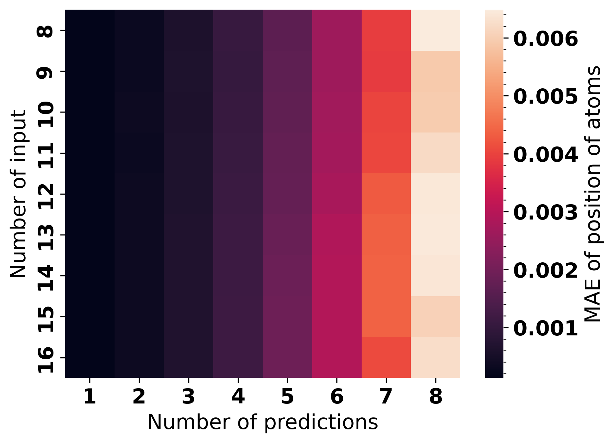
Grid search for hyperparameters

Slide 5
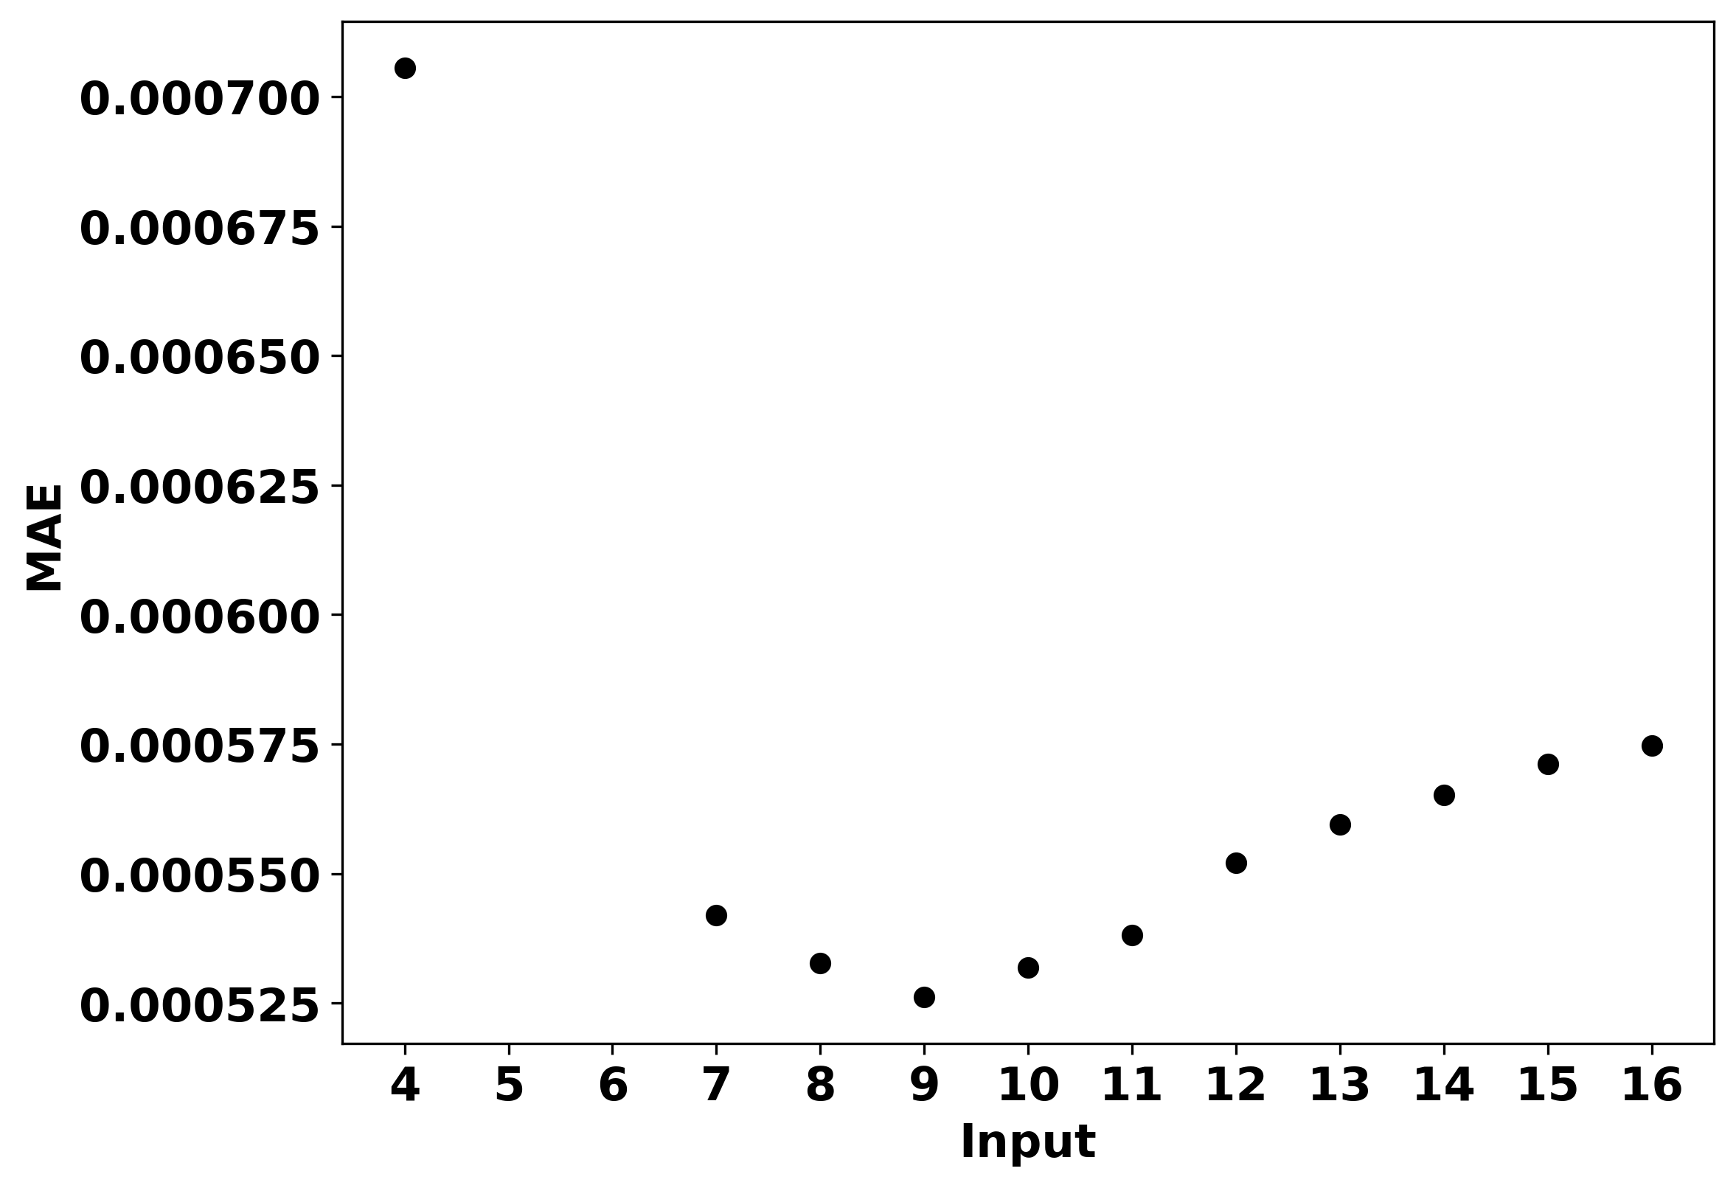
Effect of input on MAE, max pred=4

Slide 6
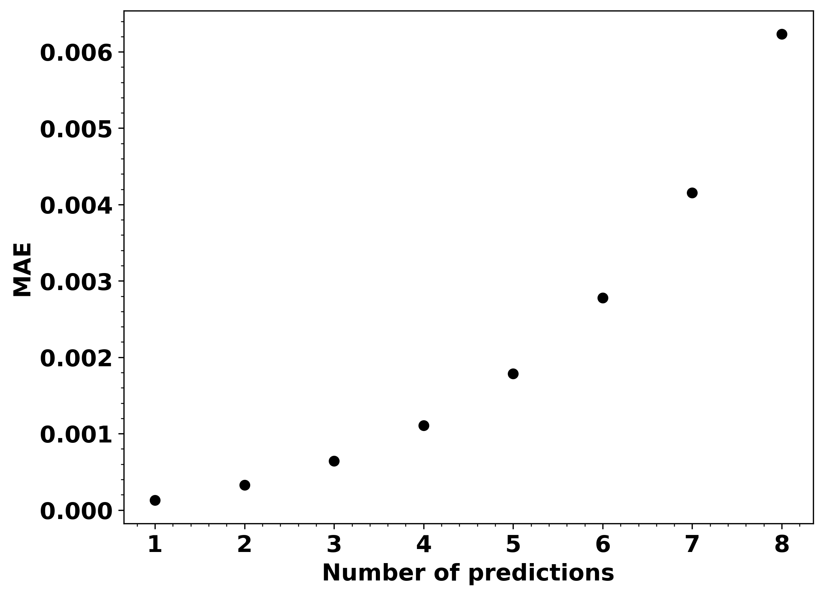
Effect of number of predictions on MAE

Slide 7
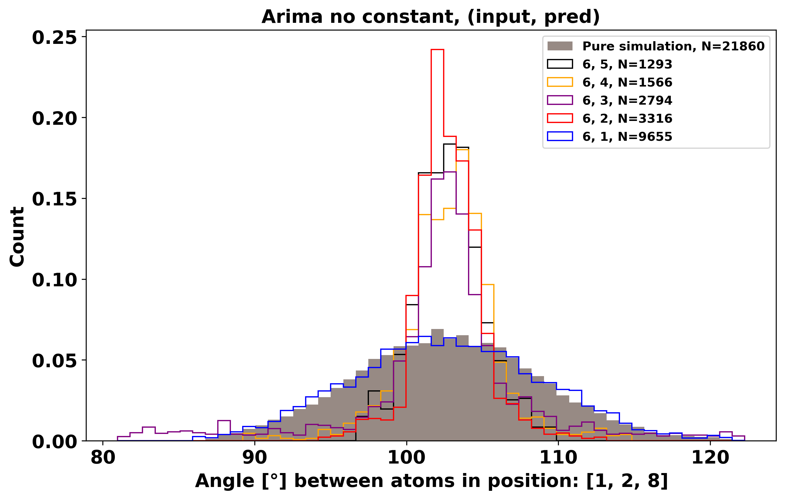
ARIMA Models with different number of predictions
Higher number of predictions might perform better with regularization

Slide 8
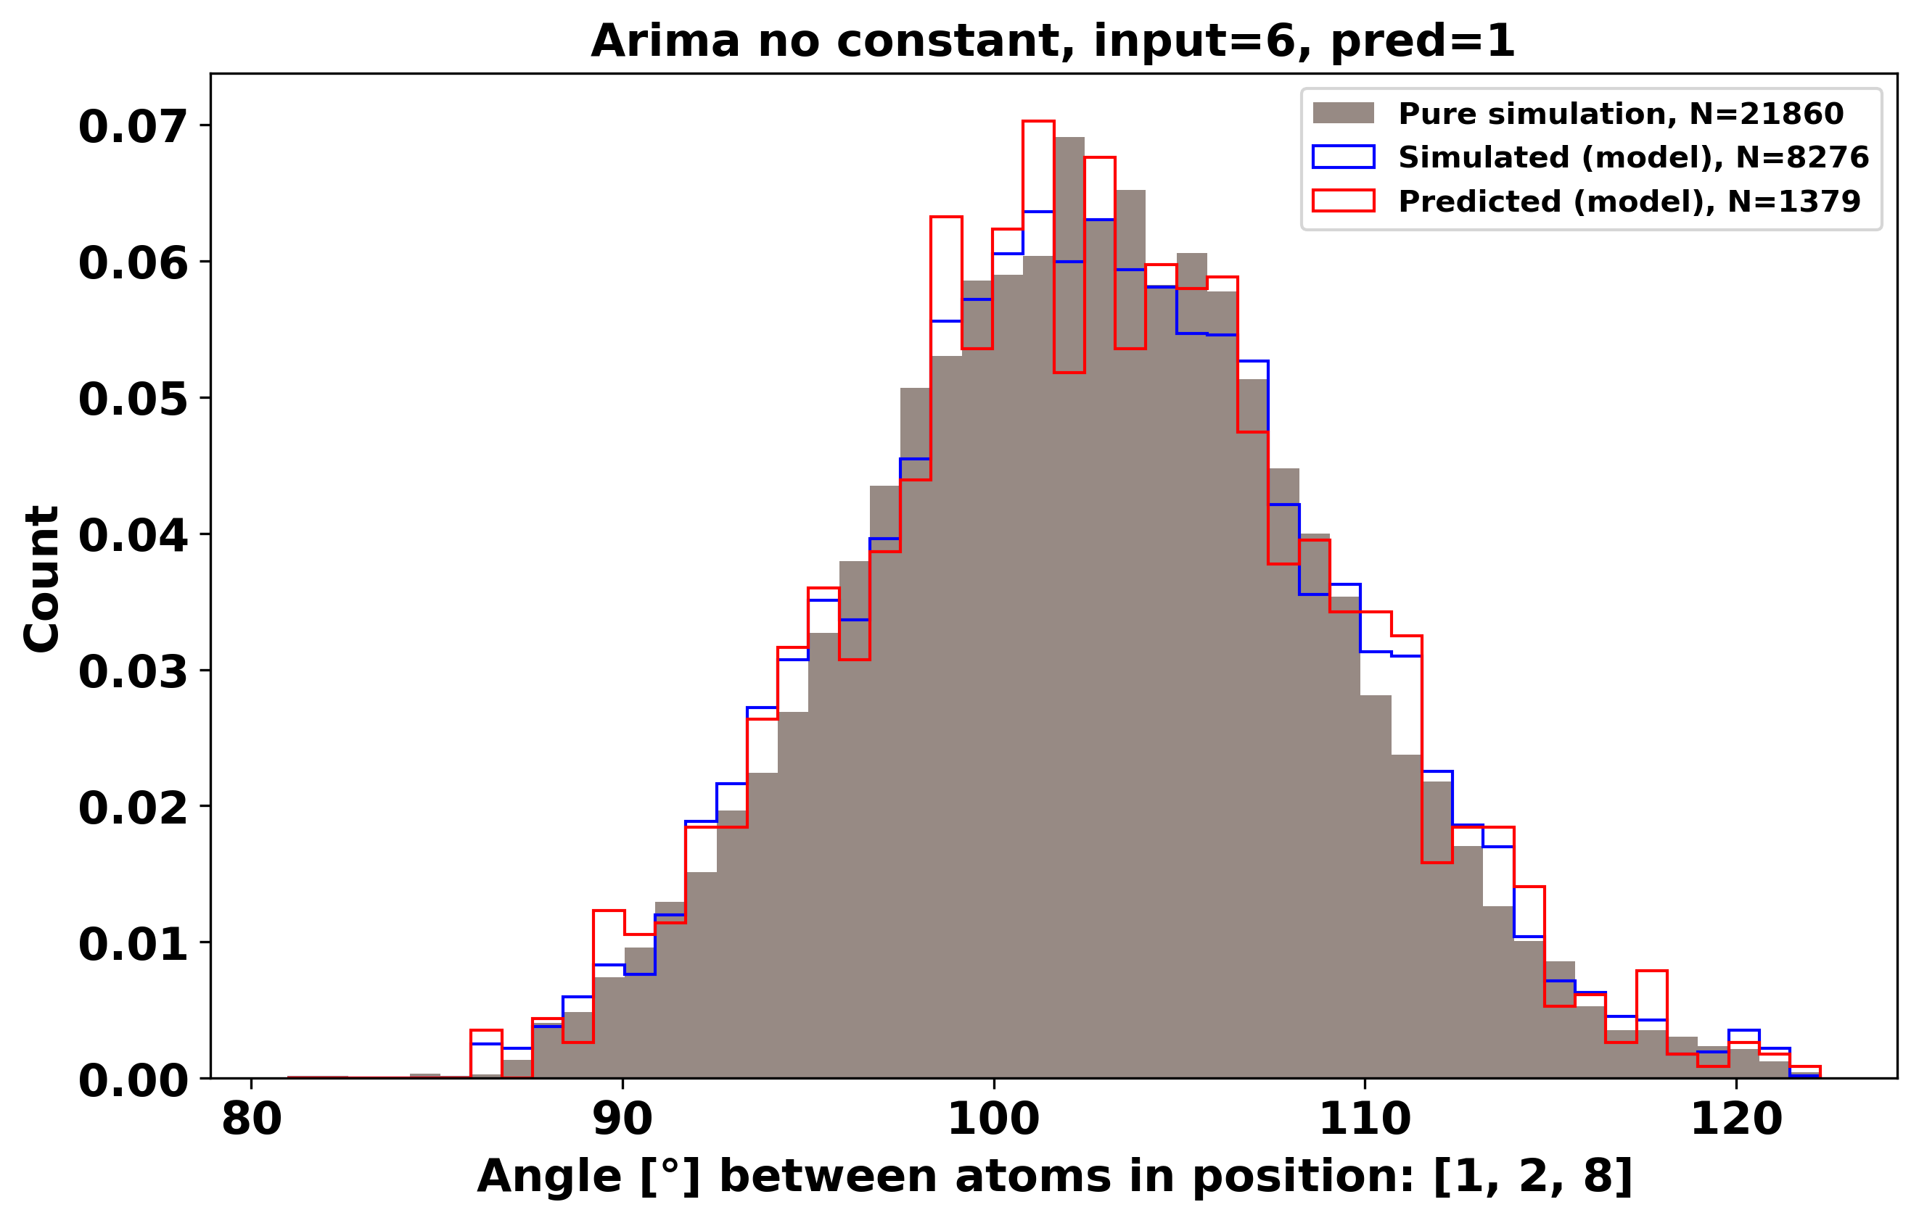
Check how it looks with higher prediction

Slide 9
Future tasks/problems
ARIMA model does not always converge
No Regularization on ARIMA
LU Decomposition when fitting model
Seeing how input = 8 works
Check the distribution of parameters in the models for posibility of choosing better starting parameters?

